Slide 1


TRANSPORT LOGISTICS
School of CSE AI&DS C

Slide 2
TITLE: TRANSPORT LOGISTICS
Team member name | Role
Saqib Ahmed K | Team Lead & Product Manager
Navadheep G P | Developer and Customer Lead
Yuvaraju Karthik | Developer Designer and Marketing
Ragul A | Debugger and Tester
Prashamsha S | Business Analyst

Slide 3
ABSTRACT:
TransL is an AI-based logistics solution built for small and medium trucking businesses that still depend on phone calls and WhatsApp groups to find suitable loads and trucks. The system reduces this manual effort by automatically comparing route, weight, cargo type, truck capacity, and schedule. The output is a ranked list of best truck options, shown through a web prototype with simple user forms and live match results. In simple words, the project aims to save time, reduce fuel waste, improve truck utilisation, and increase earnings per trip.
Core value
The project changes manual load planning into a faster digital workflow where a shipper can post a load and immediately view the best available trucks.
Expected impact
Better truck fill rate, fewer empty return trips, less fuel loss, and a smoother booking decision for logistics users.
3

Slide 4
Introduction:
In the present logistics ecosystem, many small fleet owners and shippers work with unstructured communication. A truck owner may spend hours calling brokers, and even after that the vehicle can return empty. This creates unnecessary fuel use, more operating cost, and lower profit. Load Match was designed to address this exact problem through a simple digital platform that automates load planning and reduces delay.
Problem statement:
Small trucking and logistics businesses in India often depend on manual processes such as WhatsApp groups and phone calls to match cargo with available trucks. This approach is inefficient and frequently results in trucks operating below full capacity. The proposed AI solution intelligently matches cargo with trucks and helps automate day-to-day decision making.

Slide 5
Technology and Domain:
Domain
AI component
The project belongs to the logistics and transportation domain, with a focus on load planning, freight movement, and fleet utilisation for Indian trucking businesses.
The system does not rely on a large complex model in the prototype. Instead, it uses intelligent rule-based scoring that behaves like a practical recommendation engine for logistics use.
Technology stack
Future technical scope
The prototype uses HTML for structure, CSS for styling, and JavaScript for user interaction, page navigation, and AI scoring logic. The application is developed as a web-based proof of concept.
The same concept can later be extended with Node.js or Python APIs, a database, GPS data, map services, and notification features for a production system.
5

Slide 6
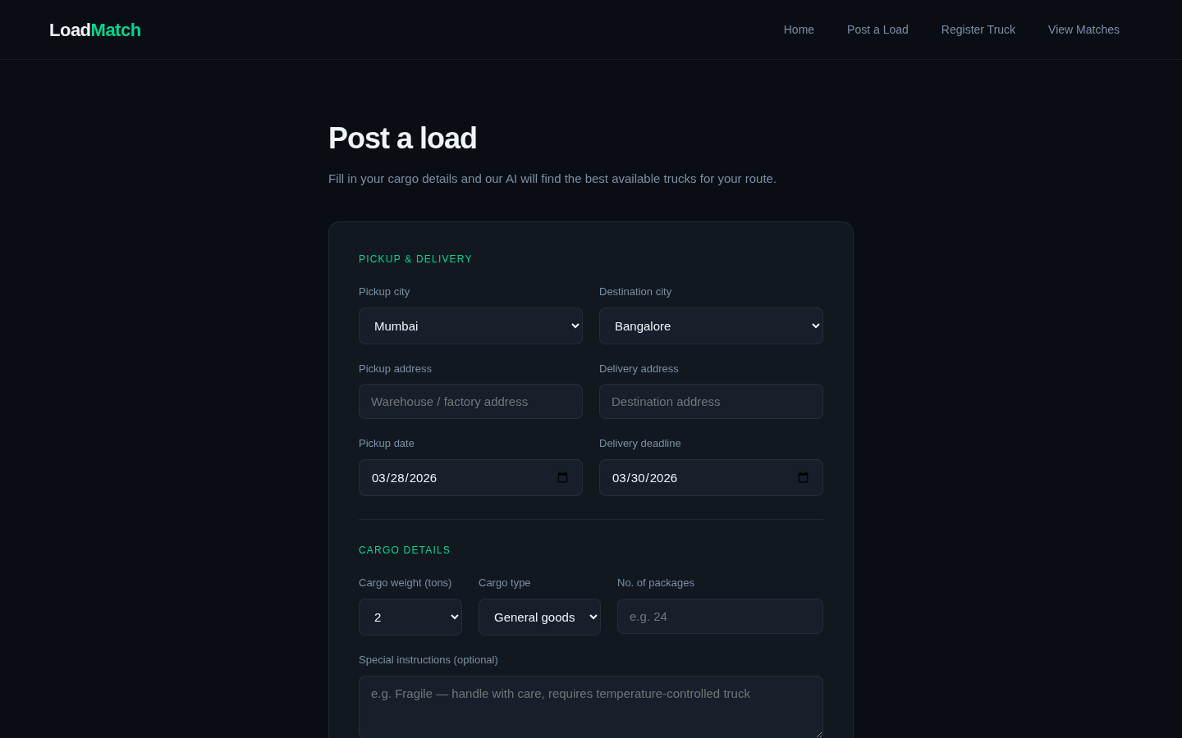
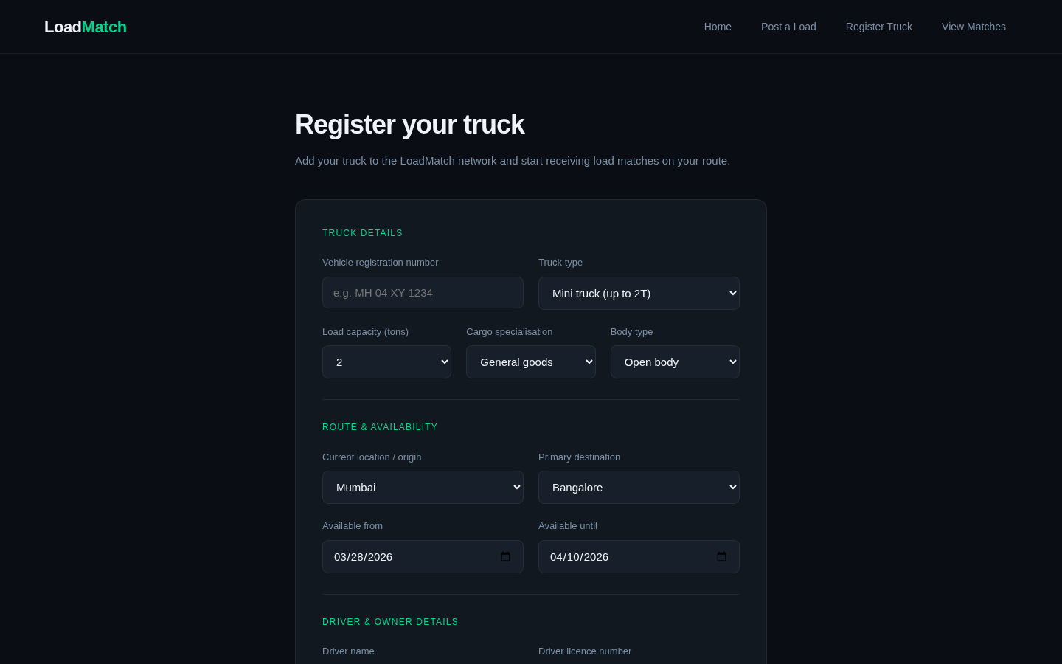
Front End and Back End Details:
Front End
The user interface is built using HTML, CSS, and JavaScript. It provides a landing page, a load posting form, a truck registration form, and a results page. The design follows a modern dashboard-like experience but keeps the flow simple enough for first-time logistics users.
Back End
At prototype level, the back-end behaviour is simulated in JavaScript. Sample truck records are stored in arrays, and a scoring function processes route coverage, capacity fit, cargo compatibility, and date availability. In a real deployment, this logic can be connected to a database and API services.
6

Slide 7
Objectives:
Reduce empty trips
Automate matching
Save fuel and cost
Improve profit
The project aims to minimise trucks running empty or half-filled, especially on return journeys.
The user should not depend on repeated calls because the system automatically recommends suitable trucks.
Improved route and capacity decisions can reduce waste and improve business efficiency.
Better load utilisation means better earnings per trip for fleet owners.
In simple words, the objective is to give logistics users a practical digital tool that is easy to use, fast enough for daily work, and valuable from the very first trip. The system should help both shippers and truck owners make quicker and smarter decisions with less manual effort.

Slide 8
Methodology:
1. Data entry
The shipper posts load details and the truck owner registers vehicle details through the web forms.
2. Parameter collection
The system reads route, weight, capacity, cargo type, and date fields from the input.
3. AI scoring
Each available truck is evaluated using matching logic that adds or reduces score based on suitability.
4. Ranking
All candidate trucks are sorted in descending order so that the best option appears first.
5. Decision output
The platform shows the final ranked results to support quick confirmation and booking.

Slide 9
Dataset:
For the prototype, the dataset is a small but meaningful collection of sample truck records written directly inside the JavaScript code. Each record stores company name, registration number, truck capacity, current origin, travel route, cargo specialisation, available date, and driver name. This is enough to demonstrate how AI-style matching works before connecting the platform to a live database.
Company | Capacity | Route | Cargo type
Sharma Transport | 20T | Mumbai → Pune → Hyderabad → Bangalore | General goods, Chemicals
Kumar Logistics | 10T | Delhi → Jaipur → Ahmedabad → Mumbai | General goods, Fragile items
Patel Freight | 15T | Ahmedabad → Mumbai → Pune → Bangalore | General goods, Perishables
Singh Carriers | 8T | Mumbai → Bangalore → Chennai | General goods, Fragile items
Reddy Express | 18T | Hyderabad → Bangalore → Chennai | Perishables, Chemicals

Slide 10
All Modules Explanation:
Home Page
Post a Load
Introduces the platform, its benefits, and the main navigation options.
Allows shippers to enter pickup city, destination, weight, cargo type, and date.
Register Truck
AI Match Engine
Allows truck owners to enter capacity, route, availability, and driver details.
Processes the available data and calculates a score for every truck.
Match Results
Future Analytics
Shows ranked trucks with match score, explanation, and suitability breakdown.
Can later report utilisation, fuel savings, revenue trend, and empty-trip reduction.

Slide 11
Conclusions and Application Development Progress:
Application progress:
The project successfully demonstrates how AI-style matching can improve day-to-day logistics decisions for small trucking businesses. The prototype is already capable of collecting load details, registering trucks, and displaying ranked matches in a way that is easy to explain and easy to use. Even in this early stage, the system clearly shows how digital matching can reduce manual effort, improve truck utilisation, and support better profitability.
Problem identified
User understanding completed
Prototype UI developed
AI scoring logic implemented
Publication / patent status:
Not yet filed in the current prototype stage; future filing can be considered after full development and validation.
Demo-ready workflow available

Slide 12
Reference and Documentation Status:
Reference
Documentation status
The main references for this presentation are the uploaded academic review PPT, the TransL HTML/CSS/JavaScript prototype, project survey findings, and practical observations of current manual logistics workflows. These references were used to keep the project explanation aligned with the reference deck while updating the content into a more professional presentation style.
Completed documents include problem statement, project idea, objectives, methodology, UI flow, module explanation, and prototype demo material. The remaining work includes detailed testing notes, expanded technical documentation, and the final report compilation. Overall, the project is presentation-ready and suitable for IA review with demonstration support.
Final note:
TransL is a simple AI-based logistics solution that helps shippers and truck owners save time, reduce empty trips, and improve transport efficiency through clear digital matching.

Slide 13
THANK YOU

